Slide 1

MUTUAL FUND ANALYTICS PLATFORM
Bluestock Internship Capstone Project
Presented By: Adithya B
College: Vel Tech High Tech Engineering College
Project Duration: 01 June 2026 – 12 June 2026

Slide 2
Problem Statement
The mutual fund industry generates large volumes of financial and investor data. Extracting meaningful insights from this data is essential for investors, fund managers, and financial institutions.
Objectives
Build ETL pipeline
Perform Exploratory Data Analysis
Analyze fund performance
Measure investment risk
Study investor behavior
Develop recommendation system
Create interactive Power BI dashboard

Slide 3
Data Sources:
Dataset & Purpose
Fund Master-Fund information
NAV History-Daily NAV tracking
AUM-Industry growth
SIP Inflows-Investor activity
Category Inflows-Fund category analysis
Folios-Industry participation
Investor Transactions-Demographic analytics
Portfolio Holdings-Sector allocation
Total Records Analyzed:
46,000+ NAV Records
Thousands of investor transactions
40 Mutual Fund Schemes

Slide 4
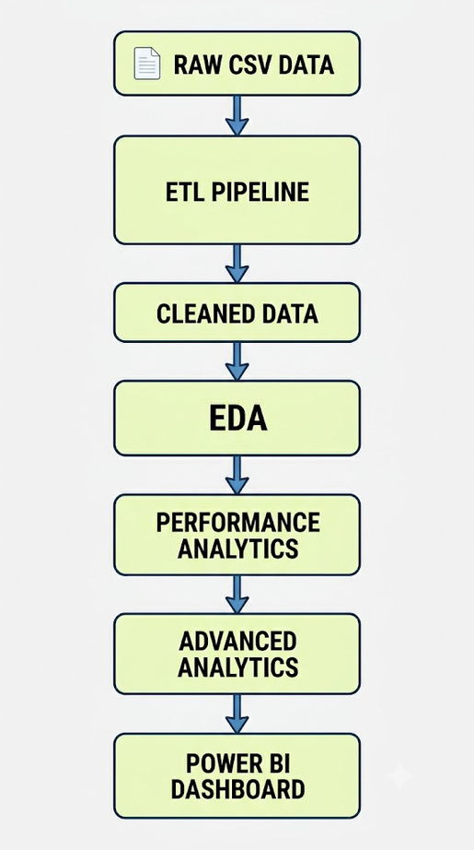
Project Architecture
Technologies
Python
Pandas
NumPy
Plotly
Seaborn
Power BI

Slide 5
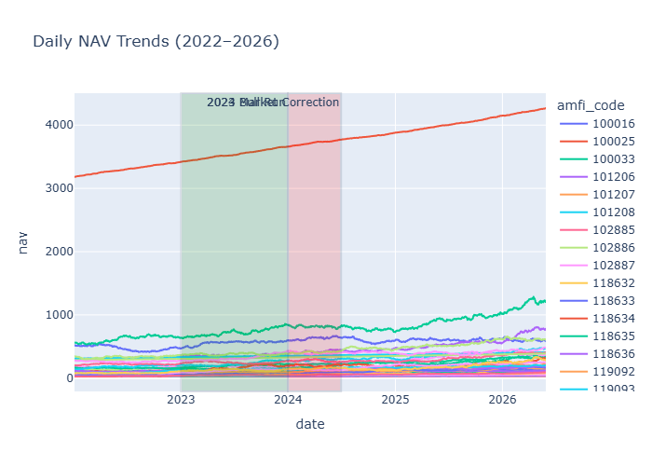
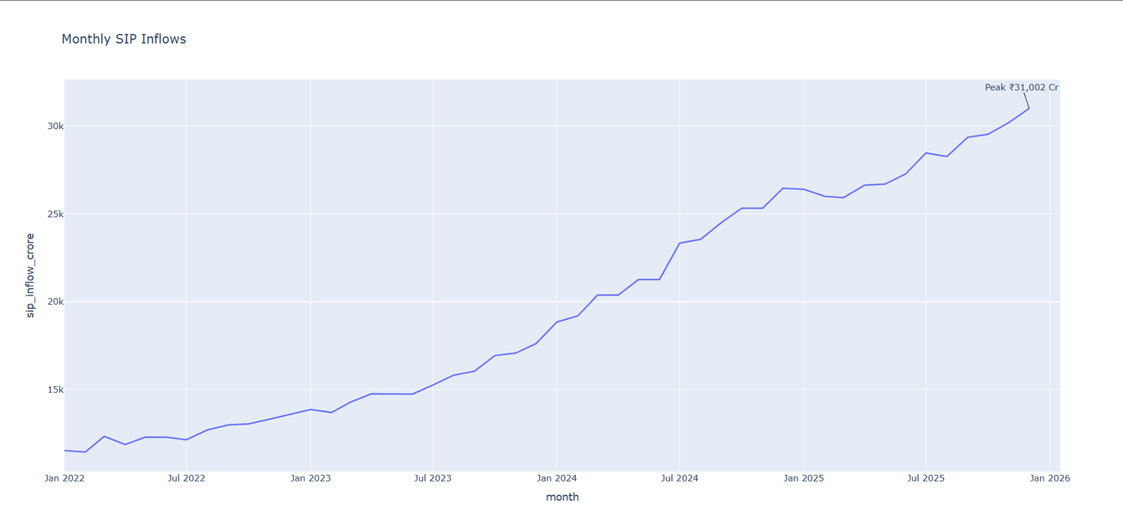
EDA Highlights
Key Visualizations
NAV Trend Analysis
SIP Growth Analysis
AUM Growth Analysis
Folio Growth Analysis
Insights
Industry AUM increased steadily
SIP inflows reached record highs
Investor participation doubled
Equity funds dominated inflows

Slide 6
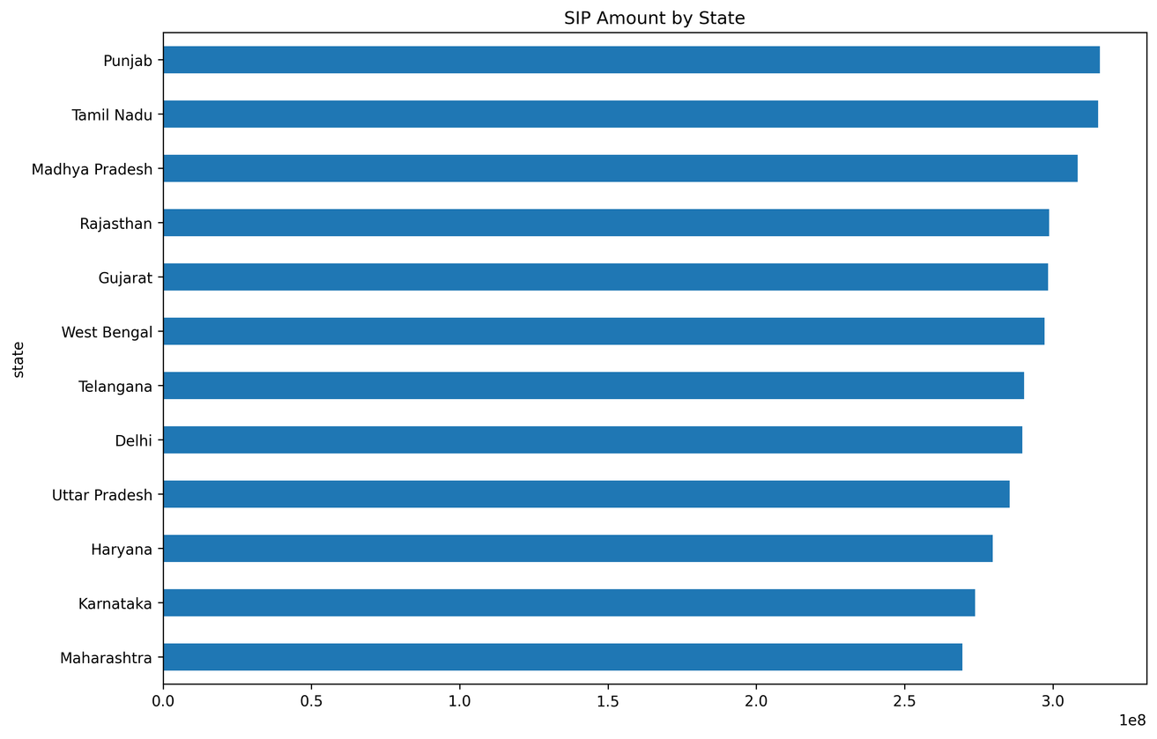
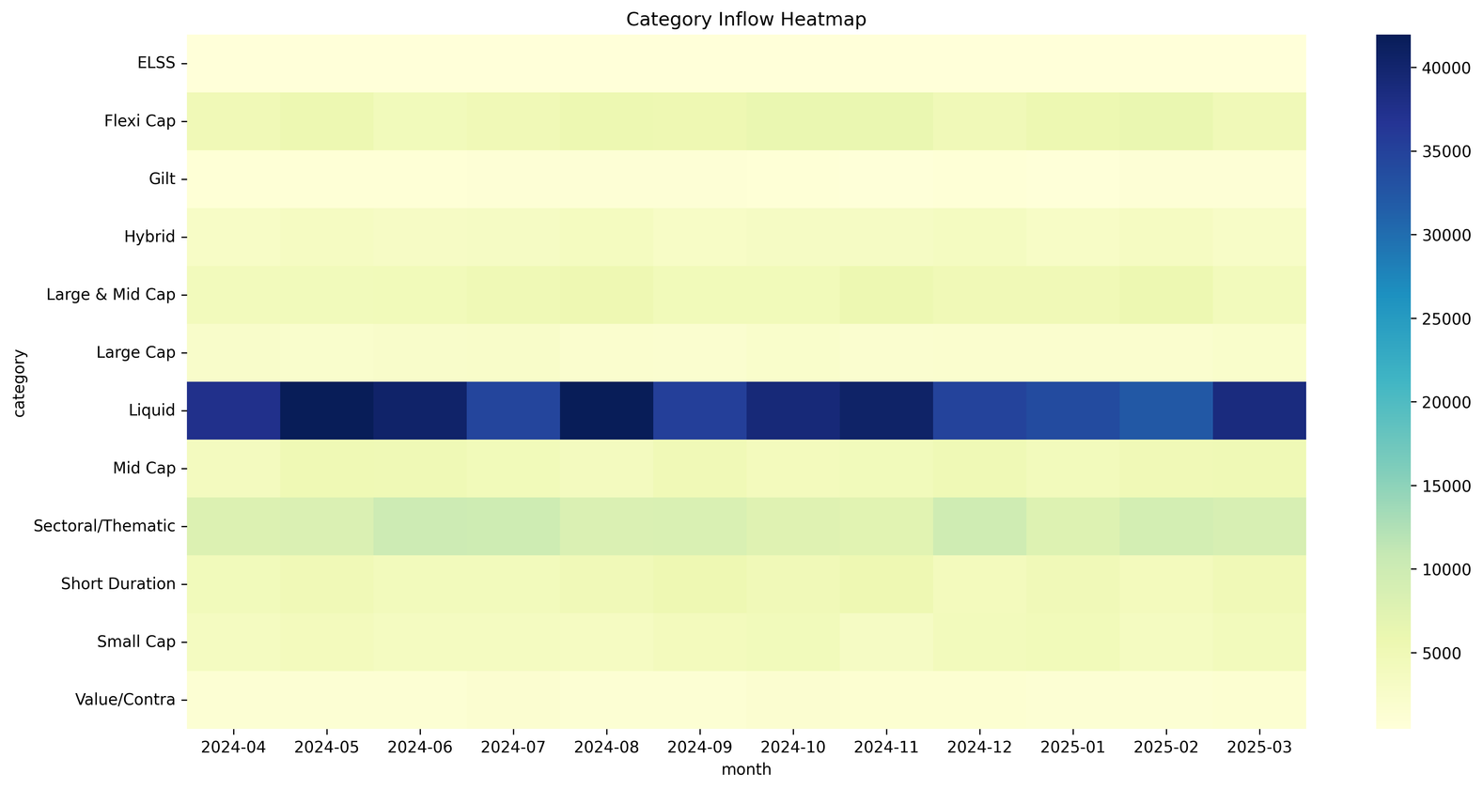
EDA Highlights
Additional Analysis
Category Inflow Heatmap
Investor Demographics
Geographic Distribution
Sector Allocation
Insights
Urban investors dominate investments
Working-age investors contribute most
Technology and Financial sectors dominate holdings
Category inflows vary significantly

Slide 7
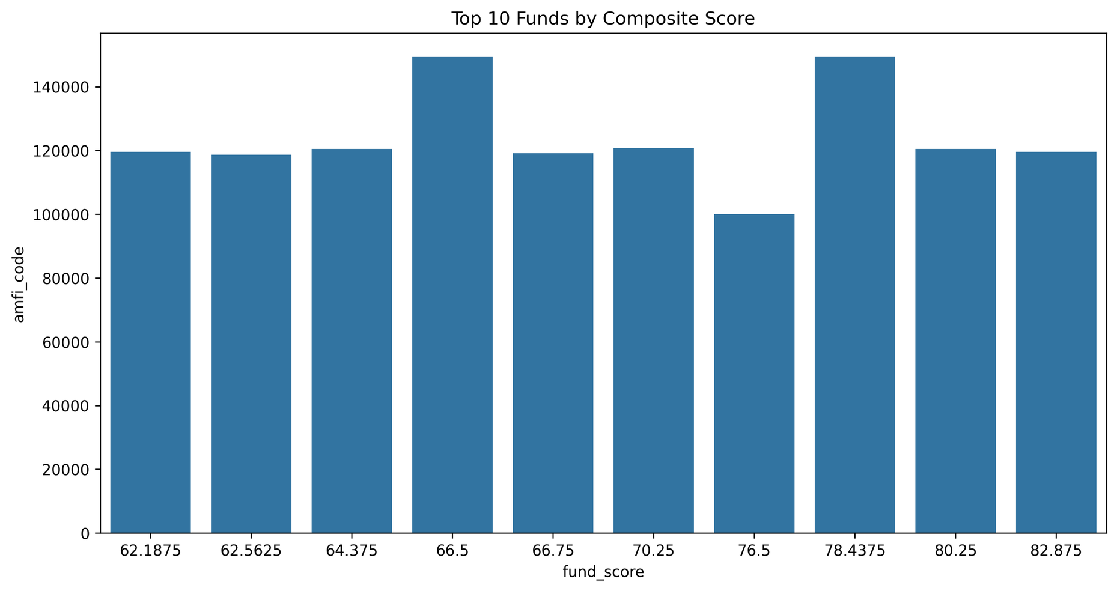
Performance Analytics
Metrics Calculated
CAGR
Sharpe Ratio
Sortino Ratio
Alpha
Beta
Maximum Drawdown
Purpose
Evaluate:
Return
Risk
Downside Risk
Market Sensitivity

Slide 8
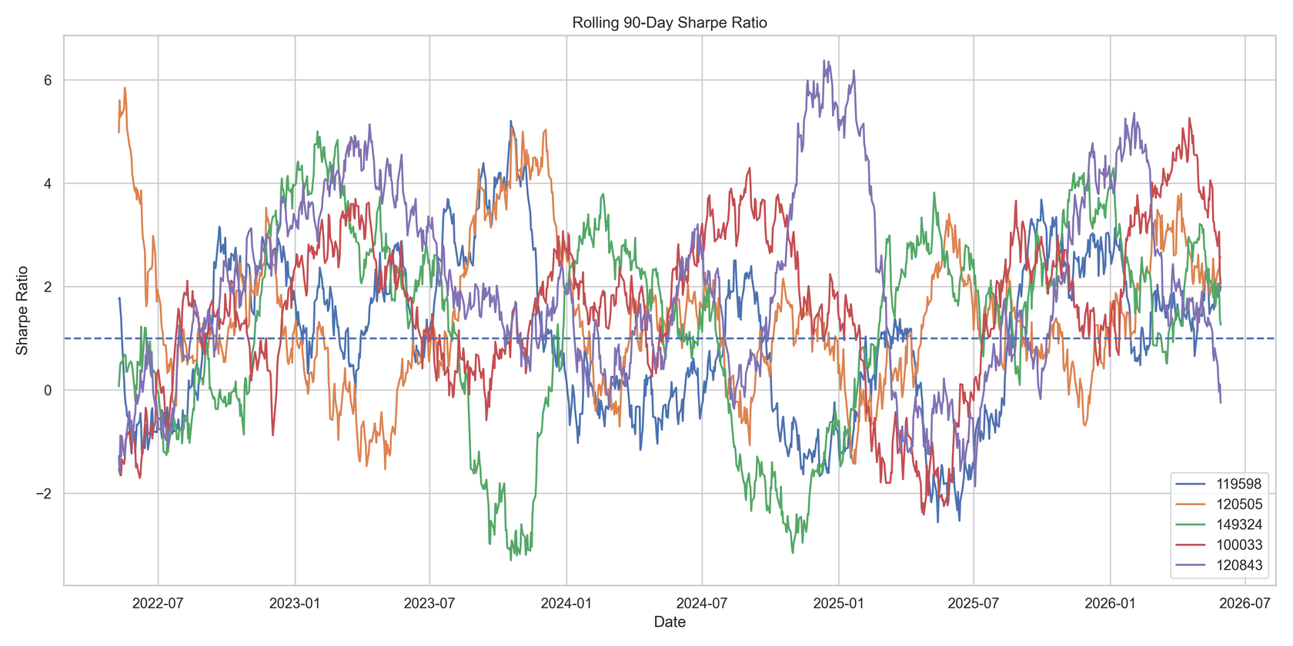
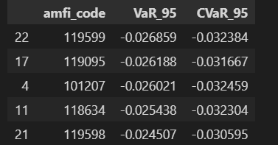
Risk Analytics
Advanced Risk Measures
Historical VaR (95%)
Conditional VaR (CVaR)
Rolling 90-Day Sharpe
Findings
Small-cap funds showed higher risk
CVaR exceeded VaR during extreme periods
Risk-adjusted performance varied significantly

Slide 9
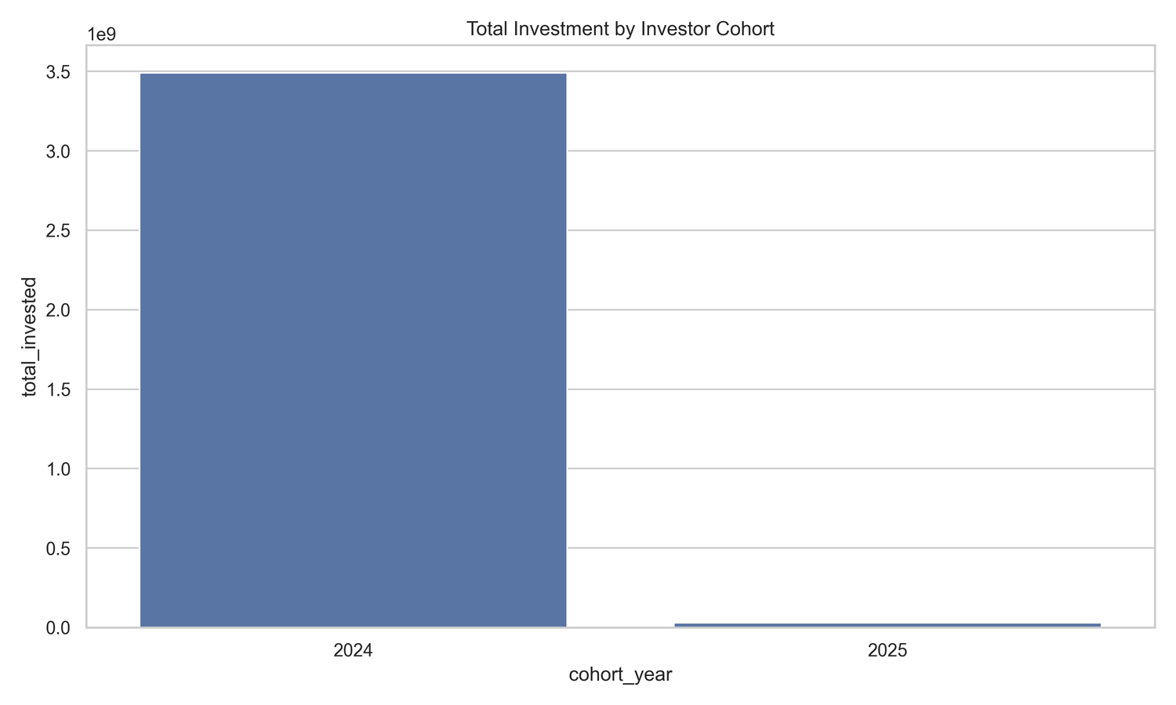
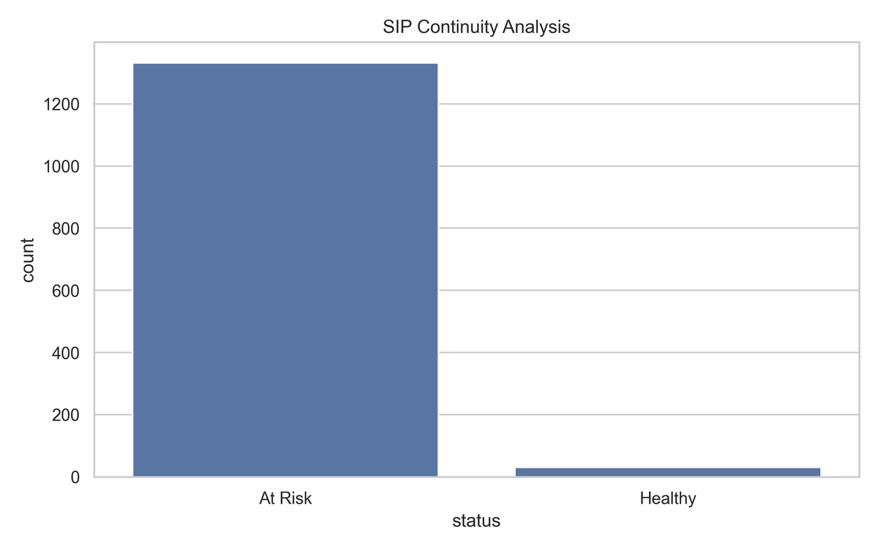
Investor Analytics
Cohort Analysis
2024 cohort contributed highest investment
SIP Continuity
Majority investors classified as At-Risk
Recommendation Engine
Fund suggestions based on risk profile

Slide 10
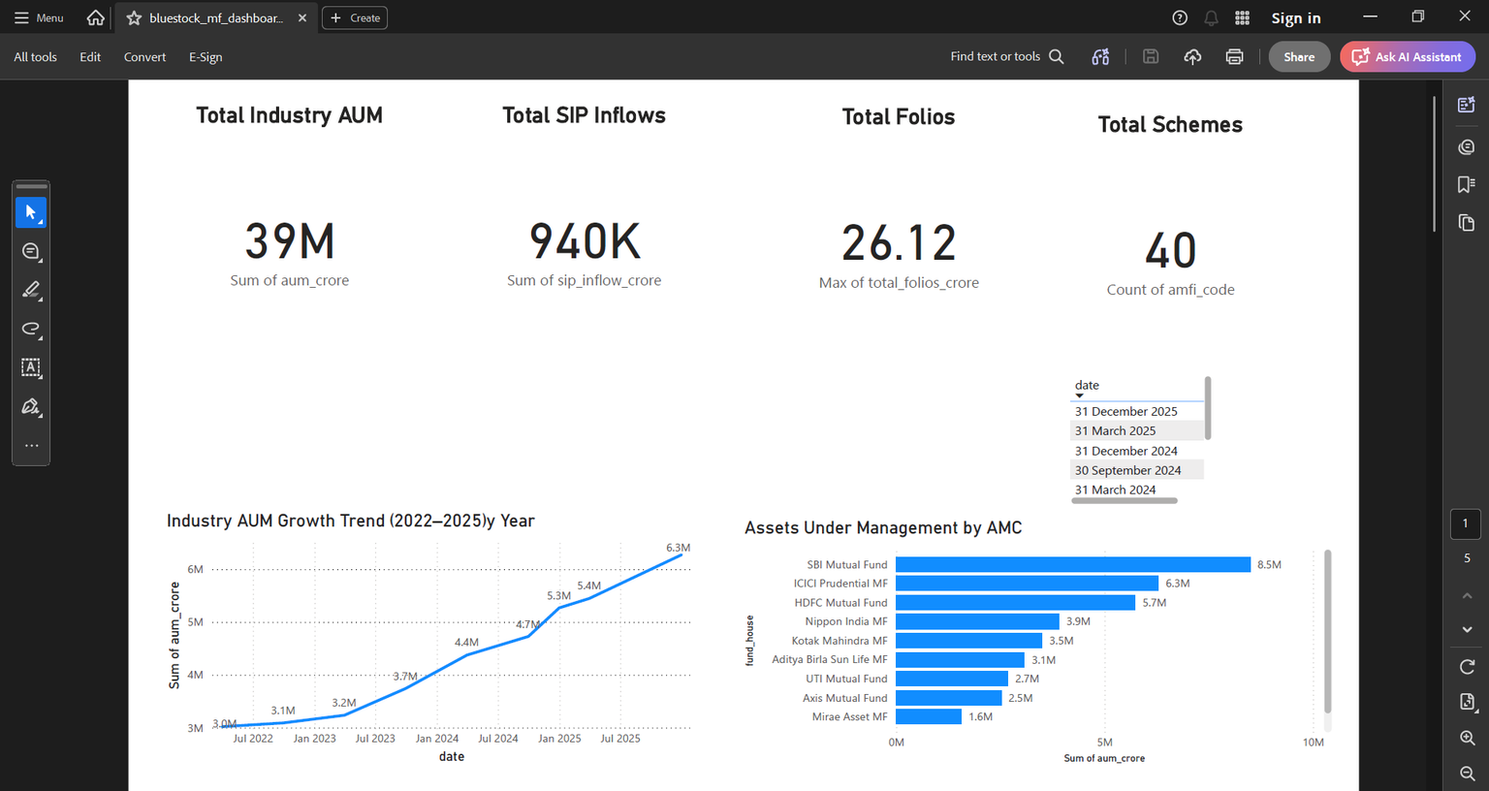
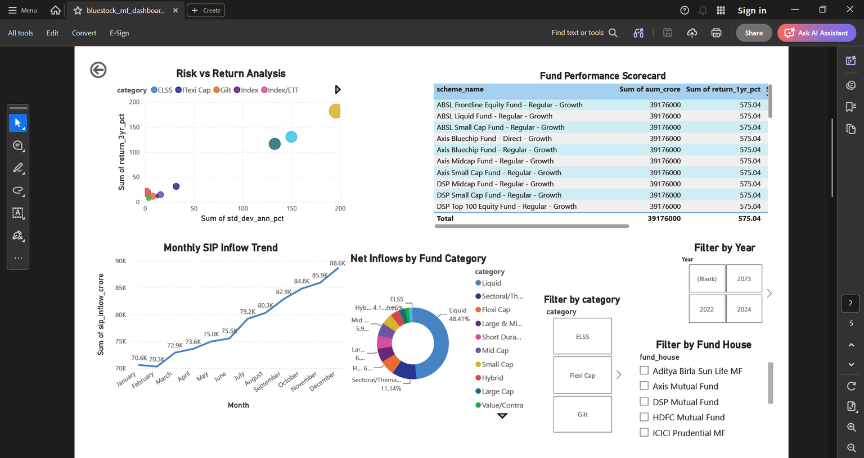
Dashboard Screenshots
Power BI Dashboard
Industry Overview
Fund Performance

Slide 11
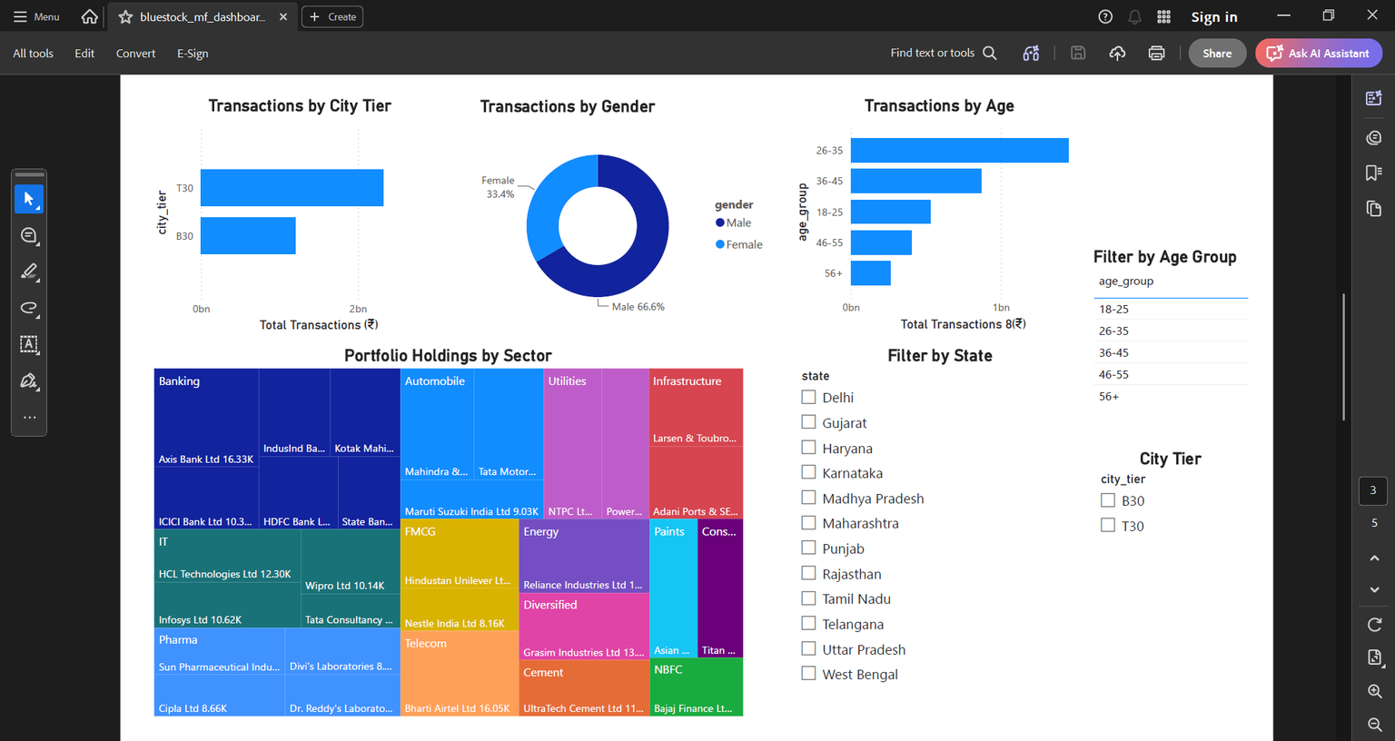
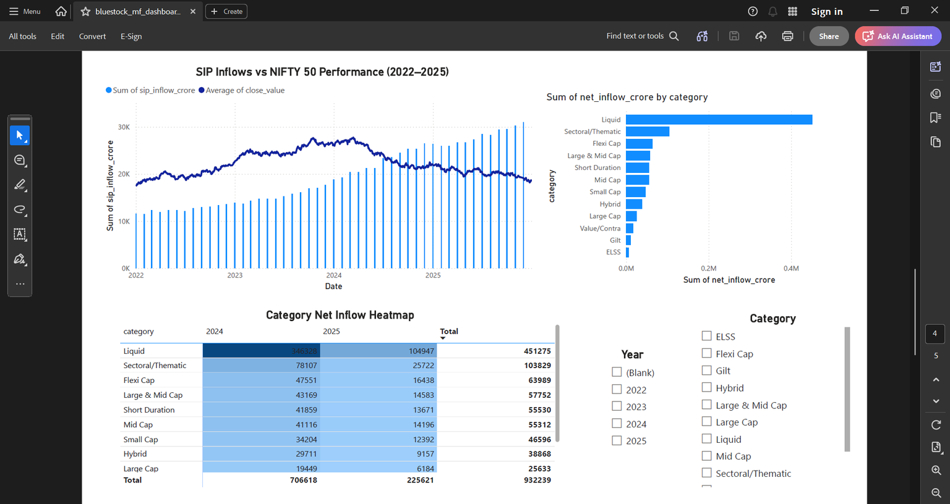
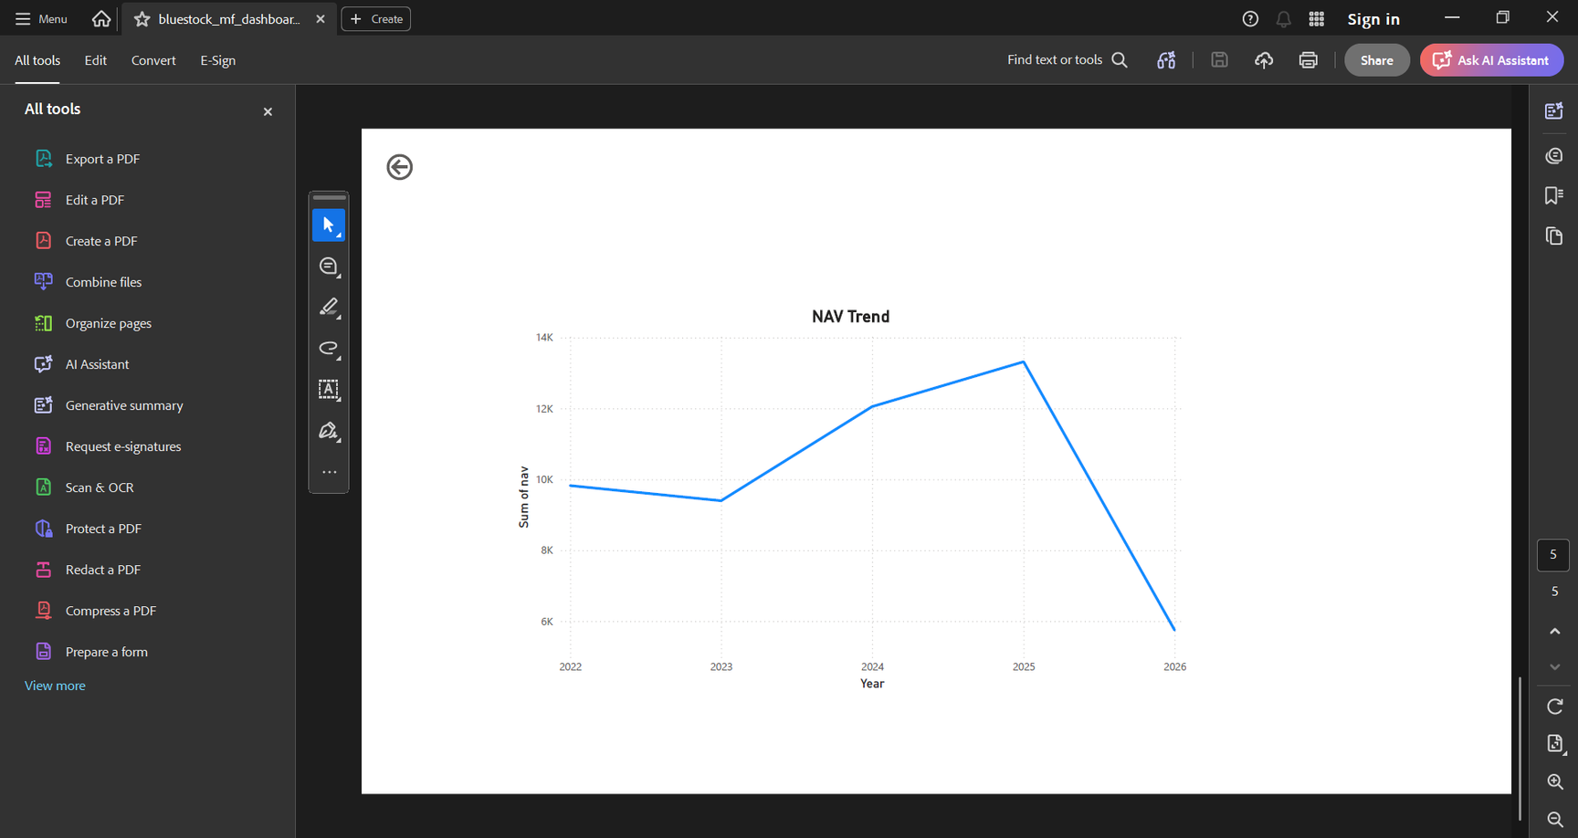
Dashboard Screenshots
Power BI Dashboard
Investor Analytics
SIP & Market Trends
Drill through

Slide 12
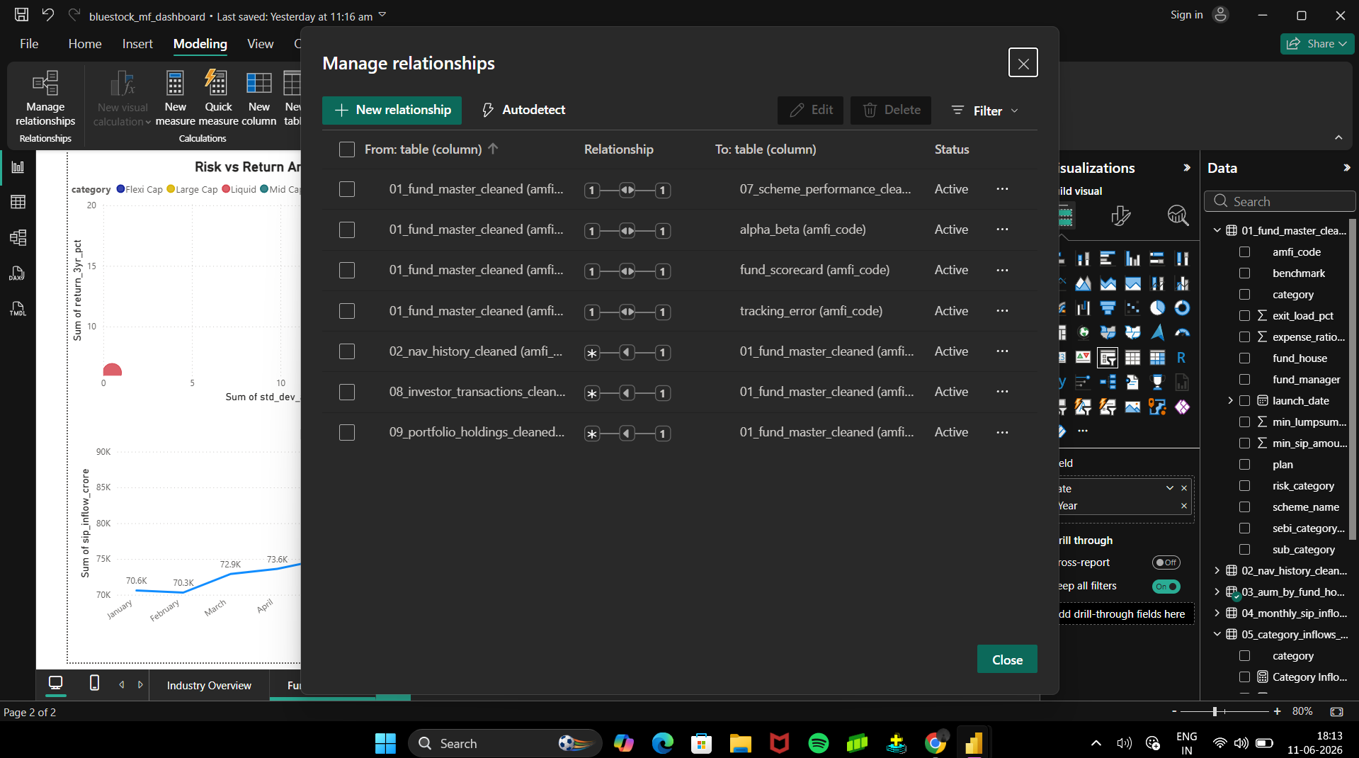
Key Findings
SIP inflows reached record levels
Folio count doubled
Small-cap funds generated highest returns
Risk-adjusted performance varied by category
Investor participation continues to grow

Slide 13
THANK YOU

